Slide 1
Model View Controller ASP.NET
By Scott Crooks
& Maggie Wettergreen

Slide 2
Overview {
MVC{
Concept and Origin;
Execution Process;
Popular Frameworks;
};
ASP.NET MVC{
MVC vs. Web Forms;
Features;
Music Store;
};
};

Slide 3
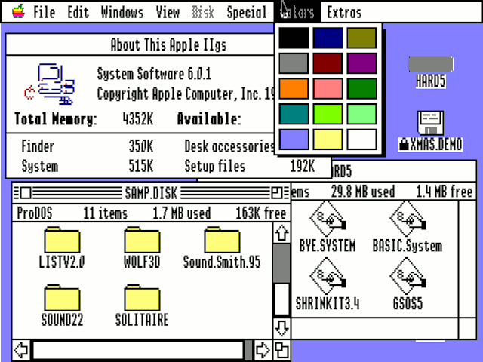
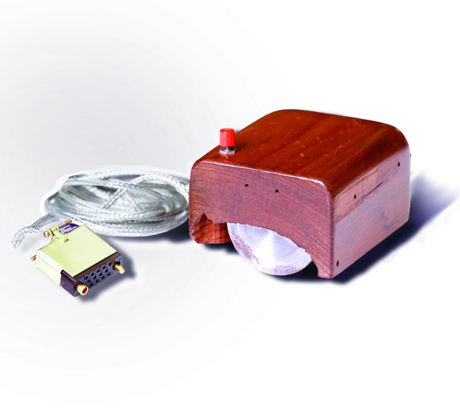
Fist Prototype of a Computer Mouse
Early Apple GUI
Introduction of graphic “views” in computing
1979
Formulated by Norwegian computer scientist Trygve Reenskaug
for Graphic User Interphase (GUI) software design, the MVC architecture was one of the primary outcomes of GUI development.

Slide 4
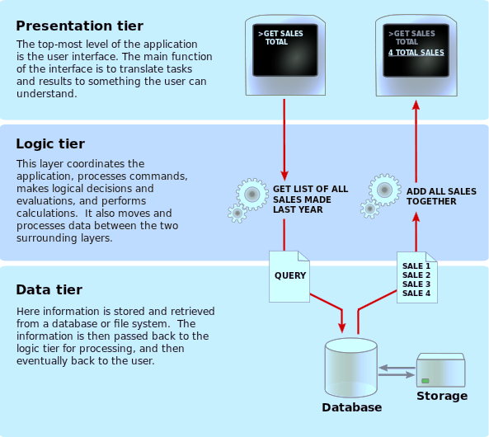
Software Architecture Pattern
Separates representation of information from user interaction.
Promotes:
Code Reusability
Separation of Concerns
Common 3-Tier Architecture Model

Slide 5
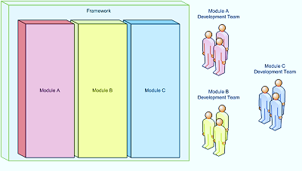
Code Reusability
Separation of Concerns
Application A
Application B
Shortens development
Code Libraries
Design Patterns
Frameworks
Improves code clarity and organization
Helps troubleshooting by isolating issues
Allows for multiple teams to develop simultaneously

Slide 6
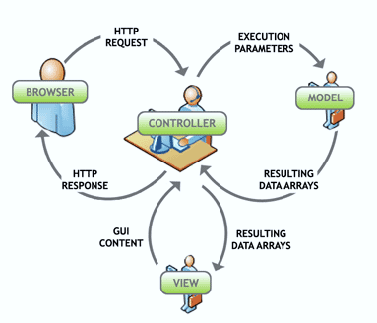
Execution Process
Controller – Mediates input and commands for the model or view
Model – Application data, business rules, logic, and functions.
View – Output and representation of data

Slide 7
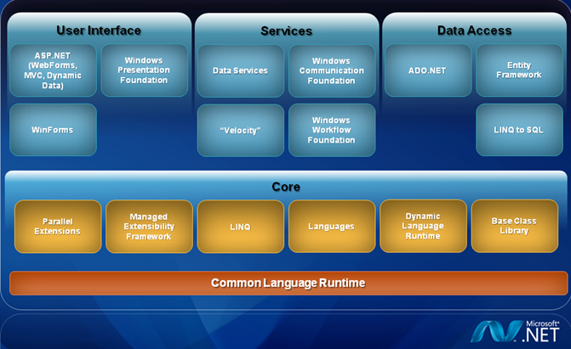
Frameworks {
ASP.NET;
PHP (Zend, Symfony, CakePHP, CodeIgniter);
Javascript ( Backbone.js, Ember.js, JavascriptMVC);
}
ASP.NET 4.0 Framework

Slide 8
ASP.NET MVC
Implements Model-View-Controller Paradigm
Integrates with Existing ASP.NET Features
Master Pages
Membership-Based Authentication

Slide 9
Advantages
MVC
WebForms
Easier to Manage Complexity
Does not use view state or server based forms
Rich Routing Structure
Support for Test-Driven Development
Supports Large Teams Well
Preservers State over HTTP
Page Controller Pattern
View state or server based forms
Works well for small teams
Development is less complex

Slide 10
Controllers in ASP.NET MVC
Requests routed to Controller::Action
Action Methods
Action Results
RESTful

Slide 11
Models
Uses Entity Framework
Database First
Model First
Code First
Database Context
Describes interactions between entities
Data Annotations
Describes additional requirements for the model

Slide 12
Views
Razor
Compact, Expressive, and Fluid
Easy to Learn
Has great Intellisense
ASPX Engine
Dynamic or Strongly Typed
Partial Views

Slide 13
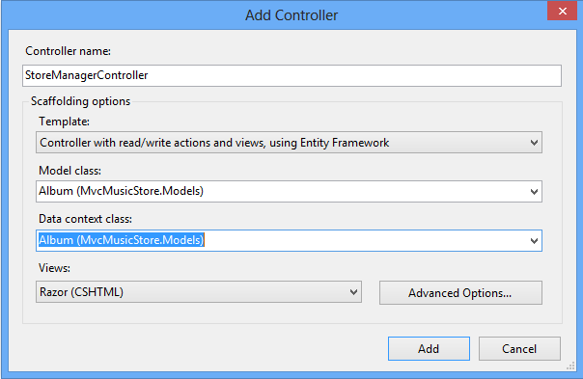
Other Features
Scaffolding
Test Driven Development
Internationalization
Many More

Slide 14
MVC Music Store
ASP.NET MVC Implementation
http://www.asp.net/mvc/tutorials/mvc-music-store

